Slide 1
PASS Community News
November 2015

Slide 2
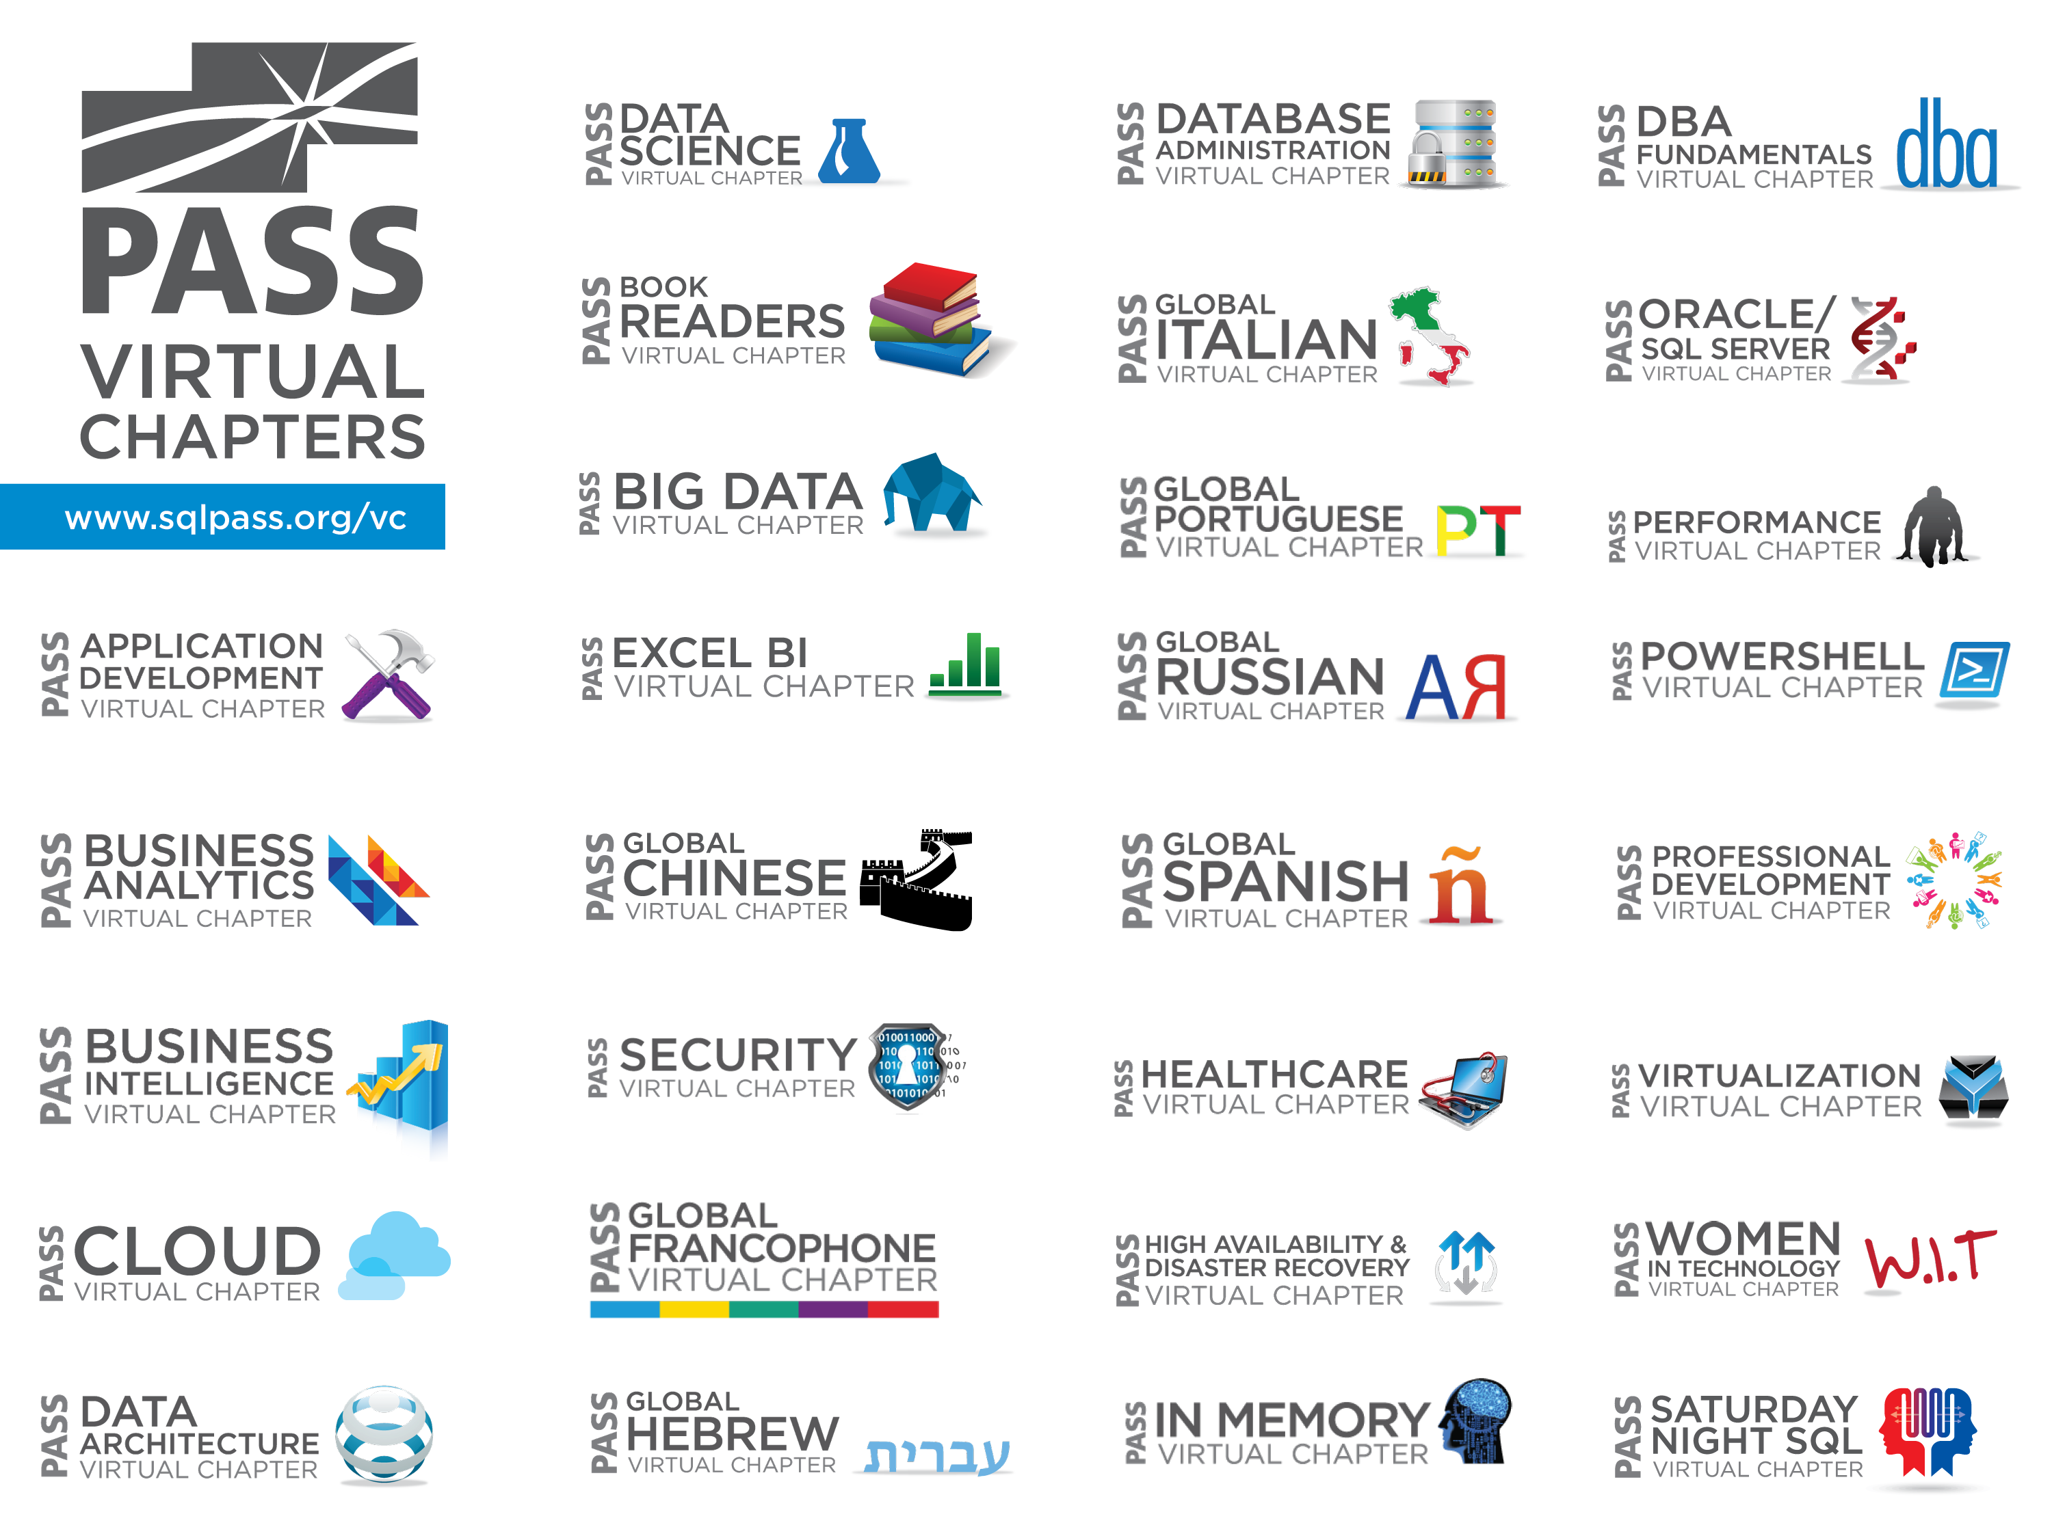

Slide 3
Select Virtual Chapter Meetings more events and info at sqlpass.org/events
VIRTUAL CHAPTER | MEETING | TOPIC
Virtualization | Nov 18 12:00-13:00 UTC-05:00 | Architecting Virtual Environments for Business Intelligence
Global Spanish | Nov 18 12:00-13:00 UTC-05:00 | JSON Support en SQL Server 2016 presented by Carlos Andres Ulate Hernandez
Business Analytics | Nov 18 12:00-13:00 UTC-05:00 | Rise of the Machine (Learning) – Azure ML in BI, in Apps, and as a product in Azure Marketplace presented by Greg Beaumont
Healthcare | Nov 19 13:00-14:00 UTC-05:00 | Health Plan – Payer Analytics: Uncover Insights, Reveal Trends, and Take Action presented by Carrie Nielsen
Performance | Nov 19 14:00-15:00 UTC-05:00 | Optimizing your data warehouse for OLAP Processing presented by Konstantin Melamud
Saturday Night SQL | Nov 21 21:00-22:00 UTC-05:00 | Reporting Tool Efficiency Discussion
Global Spanish | Nov 25 12:00-13:00 UTC-05:00 | Vista 360 grados de DataZen presented by Juan Alvarado

Slide 4

Upcoming SQLSaturdays
North America
International
Nov 21 Montreal
Nov 21 Salt Lake City
Dec 5 Washington DC
Dec 12 Providence
Jan 9 Atlanta BI Edition
Jan 16 Nashville
Jan 30 Austin
Nov 21 Madrid
Nov 21 Costa Rica BI
Nov 21 Brasilia
Nov 28 Mexico City
Nov 28 Parma
Nov 28 Belgrade
Dec 5 Lima
Dec 5 Southampton
Visit www.sqlsaturday.com to register for a event near you!

Slide 5
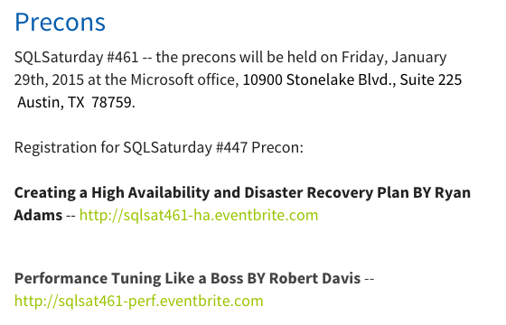
Cheap All Day Training…

Slide 6
Volunteering Opportunities
PASS would not exist without passionate, dedicated, and hardworking volunteers from around the globe.
Volunteer today!!
For local opportunities please visit volunteer.sqlpass.org
For PASS HQ related activities, please update the “MyVolunteering” section of your MyPASS profile.

Slide 7

Stay Involved!
Sign up for a free membership today at sqlpass.org
Linked In: http://www.sqlpass.org/linkedin
Facebook: http://www.sqlpass.org/facebook
Twitter: @SQLPASS
PASS: http://www.sqlpass.org

